Slide 1


BEYOND CLICKS AND KEYS:
EXPLORING VOICE ASSISTANTS
ON THE DESKTOP
BY : SANJIL K C (20BCE1855)
GUIDED BY : Dr. PRASAD M

Slide 2


01
Introduction
CONTENTS
02
Problem Statement
Research Objectives(s)
03
04
Proposed System
05
Implementation

Slide 3
06
What is to be done next
CONTENTS
Guide Approval mail
Snapshot
07
Research Paper Status
08
09
References

Slide 4



01
Introduction

Slide 5


01
Introduction
Analysts predict a growing use for digital voice assistants and devices with voice control in the next few years (Tuzovic and Paluch, 2018).
Current market analyses expect a worldwide increase from almost 2 billion dollars in 2020 to almost 7 billion dollars in 2025 for voice- and speech-recognition software (Tractica, 2020).
This technology will and has already started: it has developed into a leading-edge technology with a wide range of applications in both corporate and consumer sectors.
The example areas are healthcare, automotive industry, authentication and identification, voice commerce and customer service, and smart home (Tractica, 2020).

Slide 6
01
Introduction
When talking about digital voice assistants or smart personal assistants, we consider the so-called “general-purpose assistants”, that belong to the “adaptive voice (vision) assistants”.
Well-known examples are Google Assistant (Google), Siri (Apple), Alexa (Amazon), Bixby (Samsung), and Cortana (Microsoft).
We refer to these systems and devices with integrated voice user interfaces (VUIs) as voice assistant (VA) in the following.
On one hand, VAs are highly available in the consumer sector, as they are recently being integrated into smart devices (also, internet of Things, IoTs), tablets and personal computers.

Slide 7
02
Problem Statement

Slide 8

02
Problem Statement
Voice assistant project includes improving voice recognition accuracy, enhancing natural language processing capabilities, and developing more efficient and effective ways to interact with the user.
Voice assistants are designed to make life easier for users by providing quick and convenient access to information and services.
Therefore, it is important to ensure that voice assistants are reliable, accurate, and user-friendly

Slide 9
03
Research Objective

Slide 10


03
Research Objective
One assistant can synthesize speech more qualitatively, another can more accurately and without additional explanations and corrections perform tasks, others can perform a narrower range of tasks, but most accurately and as the user wants.
Each company developer of the intelligent assistant applies his own specific methods and approaches for development, which in turn affects the final product.
Obviously, there is no universal assistant who would perform all tasks equally well.
The set of characteristics that an assistant has depends entirely on which area the developer has paid more attention to.

Slide 11
03
Research Objective
Since all systems are based on machine learning methods and use for their creation huge amounts of data collected from various sources and then trained on them, an important role is played by the source of this data, be it search systems, various information sources or social networks.
The technologies that are used to create intelligent systems of interaction with a human by his natural language. The main technologies are voice activation, automatic speech recognition, Teach-To-Speech, voice biometrics, dialogue manager, natural language understanding and named entity recognition
The amount of information from different sources determines the nature of the assistant, which can result as a result.
Despite the different approaches to learning, different algorithms and techniques, the principle of building such systems remain approximately the same.

Slide 12
04
Proposed System

Slide 13
Proposed System Introduction
4.1
The proposed system is a versatile voice assistant designed to simplify daily tasks and enhance user convenience through voice-activated commands.
Users can seamlessly interact with the system to access information, perform tasks, and manage various aspects of their routine using natural language.
Leveraging cutting-edge voice recognition technology, the system aims to provide an intuitive and hands-free experience, catering to a diverse range of user needs.

Slide 14
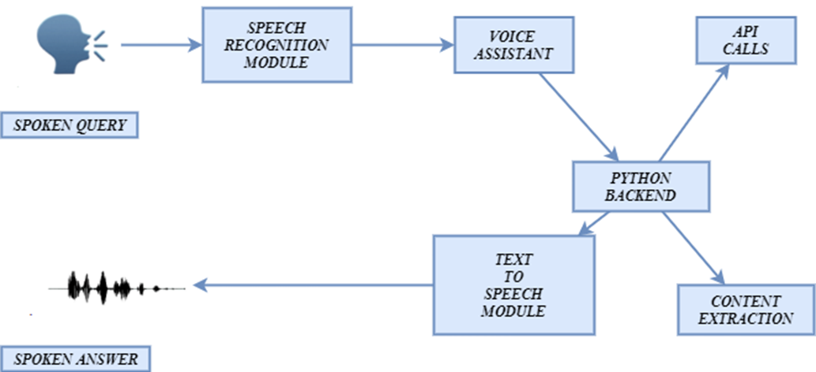
Proposed System Diagram
4.2

Slide 15
List Of Modules
4.3
Time and Date
Setting Alarms
Reminders
Weather Forecast
Language Translation
Playing Music
Search the Web
Unit Conversion
Playing Music
Open Applications

Slide 16
Weather Forecast
Algorithm:
User Prompt: User asks for weather information.
Location Retrieval: If not specified, voice assistant determines user's location.
Weather API: Voice assistant queries a weather API for current conditions or forecasts.
Response: Assistant verbally communicates the weather information to the user.
4.4
Explanation of Modules
Time and Date
Algorithm:
User Prompt: User initiates the request for the current time or date.
System Action: Voice assistant retrieves the system's current time or date.
Response: Voice assistant verbally communicates the time or date to the user.
Setting Alarms
Algorithm:
User Prompt: User instructs the assistant to set an alarm.
Time Input: Voice assistant asks for the time for the alarm.
Alarm System Integration: Assistant integrates with the system's alarm/timer functionality.
Confirmation: Assistant confirms the set alarm time.
Unit Conversion
Algorithm:
User Prompt: User specifies units and values for conversion.
Conversion Logic: Voice assistant utilizes predefined conversion formulas.
Response: Assistant verbally provides the converted value.

Slide 17
4.4
Explanation of Modules
Search The Web
Algorithm:
User Prompt: User initiates a web search.
Search Query Processing: Voice assistant processes the user's query.
Web Scraping/Query API: Assistant performs a web search and retrieves summarized information.
Response: Assistant verbally communicates the summarized information.
Language Translation
Algorithm:
User Prompt: User requests translation of a phrase or word.
Language Input: User specifies the target language.
Translation API: Voice assistant queries a translation API.
Response: Assistant verbally provides the translated phrase.
Playing Music
Algorithm:
User Prompt: User requests the assistant to play music.
Music Library Access: Assistant accesses the user's music library or a streaming service.
Playback Control: Assistant plays the specified songs, artists, or genres.
User Control: User can instruct the assistant to pause, skip, or adjust volume.
Remainders
Algorithm:
User Prompt: User instructs the assistant to set a reminder.
Task and Time Input: Assistant gathers information on the task and time.
Reminder System Integration: Assistant integrates with the system's reminder functionality.
Confirmation: Assistant confirms the set reminder.

Slide 18
4.4
Explanation of Modules
Send Text Messages
Algorithm:
User Prompt: User instructs the assistant to send a text message.
Recipient and Message Input: Assistant gathers information on the recipient and message content.
Text Messaging System Integration: Assistant integrates with the system's text messaging functionality.
Confirmation: Assistant confirms the message sent..
Open Applications
Algorithm:
User Prompt: User requests the assistant to open a specific application.
Application Recognition: Voice assistant recognizes the application mentioned.
System Integration: Assistant interacts with the system to open the specified application.
Confirmation: Assistant confirms the application is launched.

Slide 19
05
Implementation

Slide 20
Table
5.1
Module Number | Module Name | Description
1 | Time and Date | Ask your voice assistant for the current time or date.
2 | Weather Forecast | Get a quick update on the current weather conditions or the forecast for your location.
3 | Unit Conversion | Convert units like currency, temperature, or distance using voice commands.
4 | Setting Alarms | Set alarms or timers for various purposes using spoken instructions.
5 | Language Translation | Translate phrases or words into different languages on the go.
6 | Search the Web | Initiate web searches and receive summarized information on a wide range of topics.
7 | Reminders | Set reminders for tasks or events to help you stay organized.
8 | Playing Music | Control music playback by asking your assistant to play specific songs, artists, or genres.
9 | Send Text Messages | Use voice commands to compose and send text messages hands-free.
10 | Open Applications | Launch applications on your desktop with simple voice prompts.

Slide 21
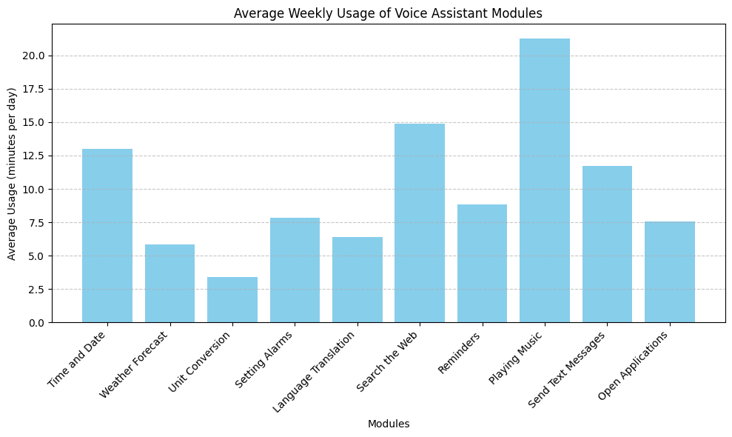
Graphs
5.2

Slide 22
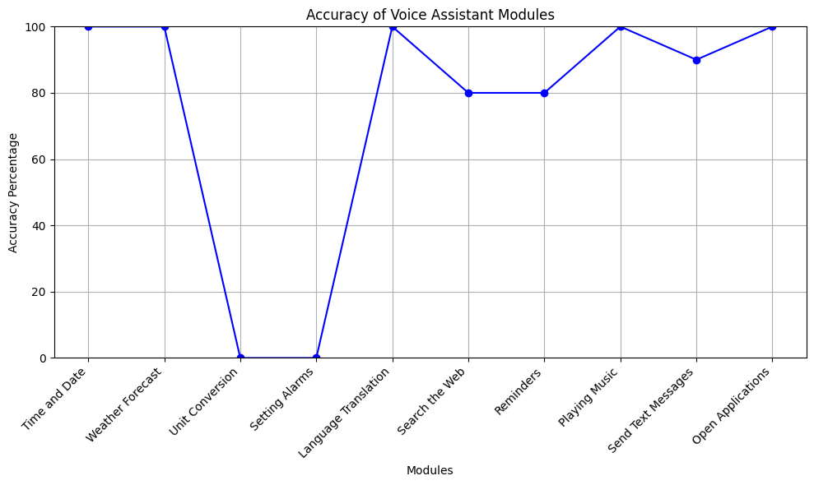
Graphs
5.2

Slide 23
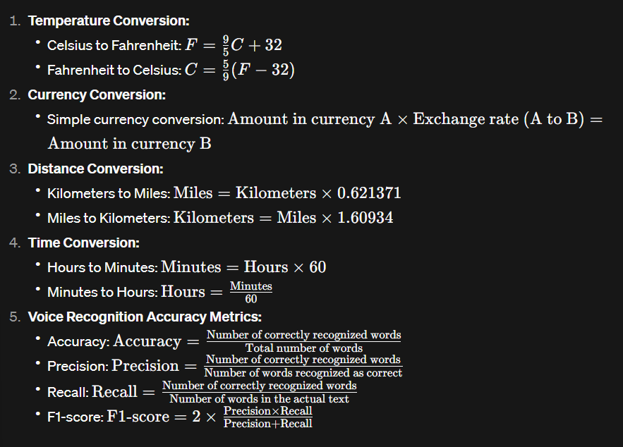
5.3
Equations

Slide 24
5.4
Findings
Time and Date
Weather Forecast
Search the Web
Understanding the history and importance of timekeeping.
Exploring climate patterns and prediction methodologies.
Harnessing the power of search engines for information retrieval.

Slide 25
5.4
Findings
Send Text Messages
Language Translation
Playing Music
Communicating efficiently and safely through voice-assisted messaging.
Bridging communication gaps across languages with translation technology.
Enjoying personalized playlists and music recommendations effortlessly.

Slide 26
5.4
Findings
Open Applications
Streamlining workflow and accessing resources with voice-activated app launching.

Slide 27

5.5
Interpretation and Discussion
Discussion
Convenience: These modules prioritize hands-free interaction, enhancing user experience and promoting adoption.
Versatility: The listed functionalities range from basic tasks to advanced features, showcasing the voice assistant's expanding capabilities.
interpretation
The provided list of modules outlines essential functionalities for a voice assistant project, catering to users' diverse needs and preferences.

Slide 28
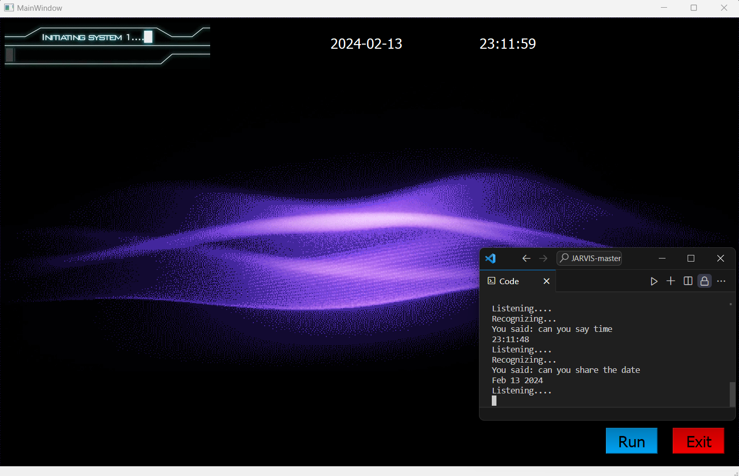
Results – Time and Date
5.7

Slide 29
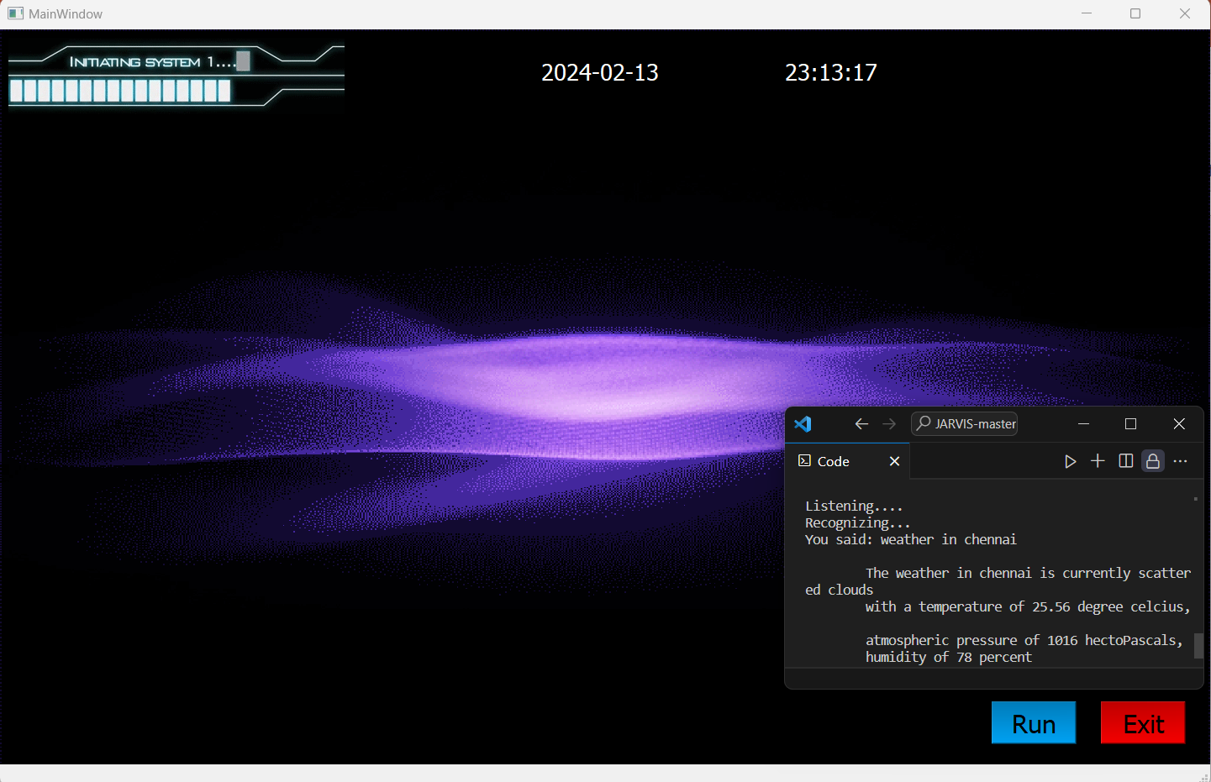
Results – Weather Forecast
5.7

Slide 30
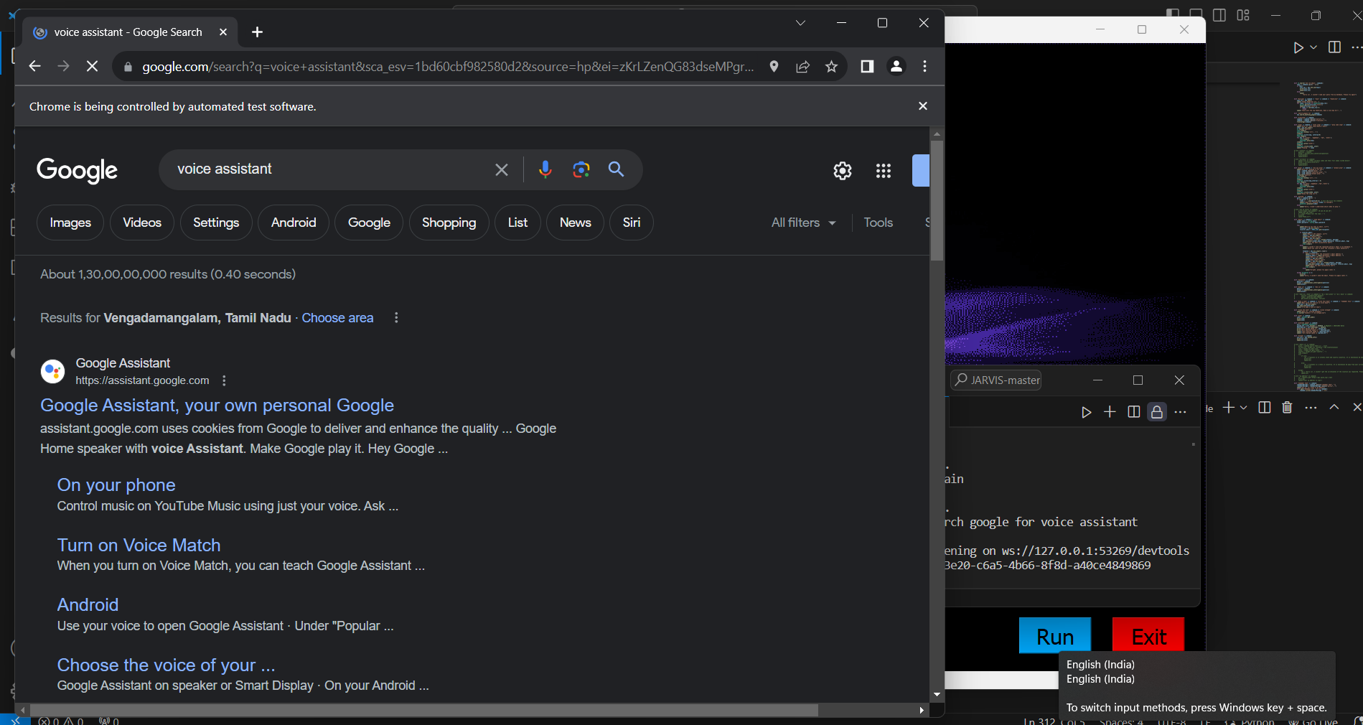
Results – Search the Web
5.7

Slide 31
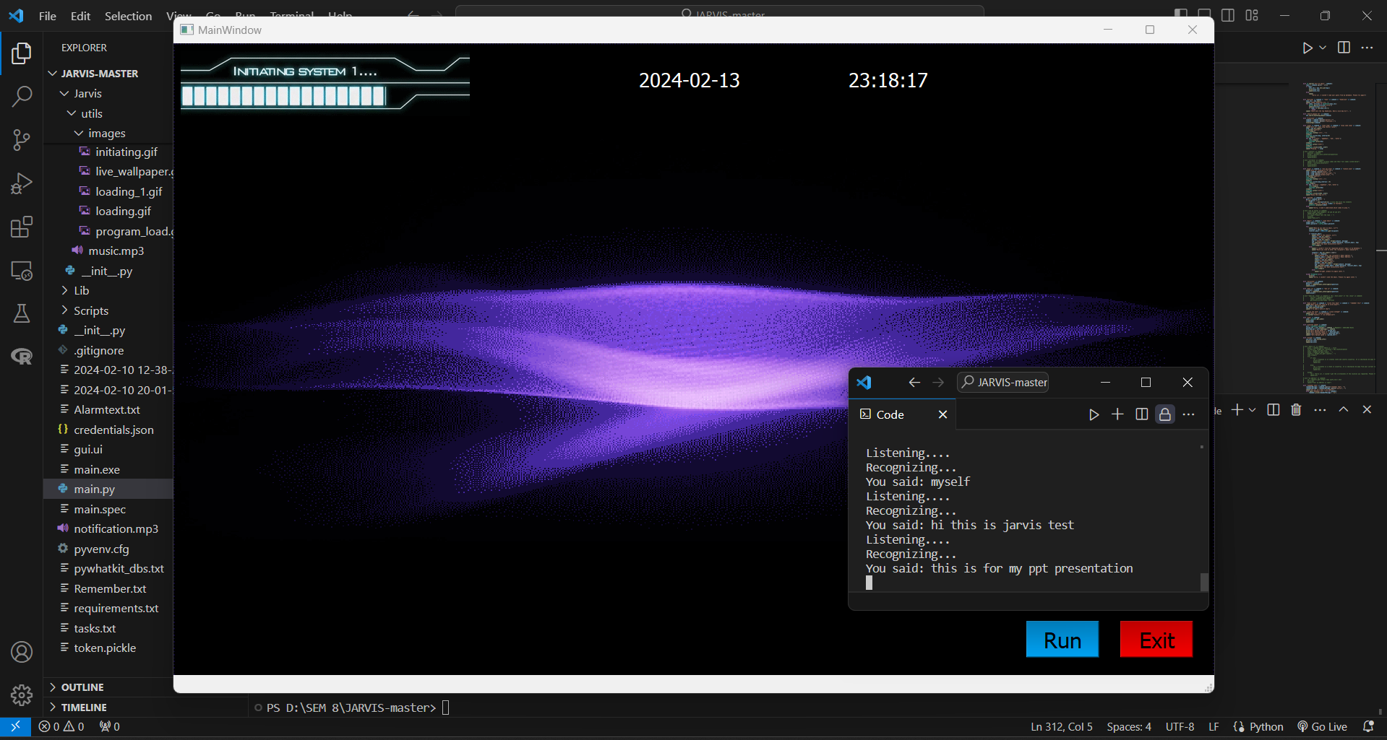
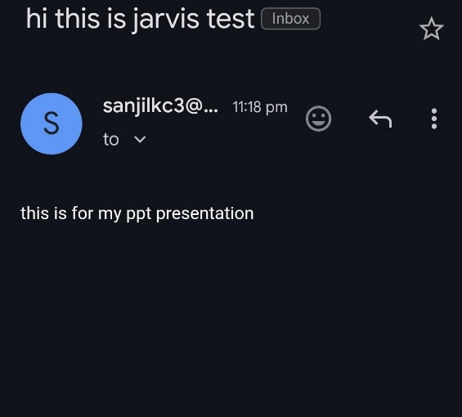
Results – Send Text Messages
5.7

Slide 32
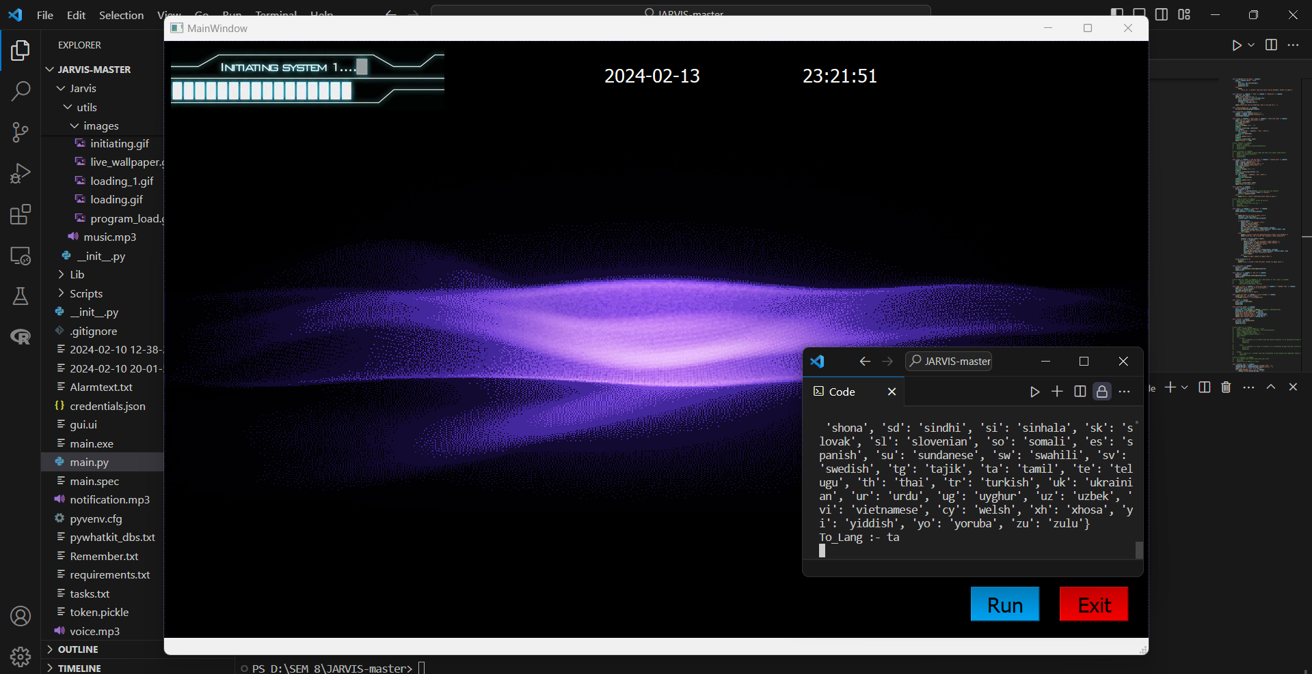
Results – Language Translation
5.7

Slide 33
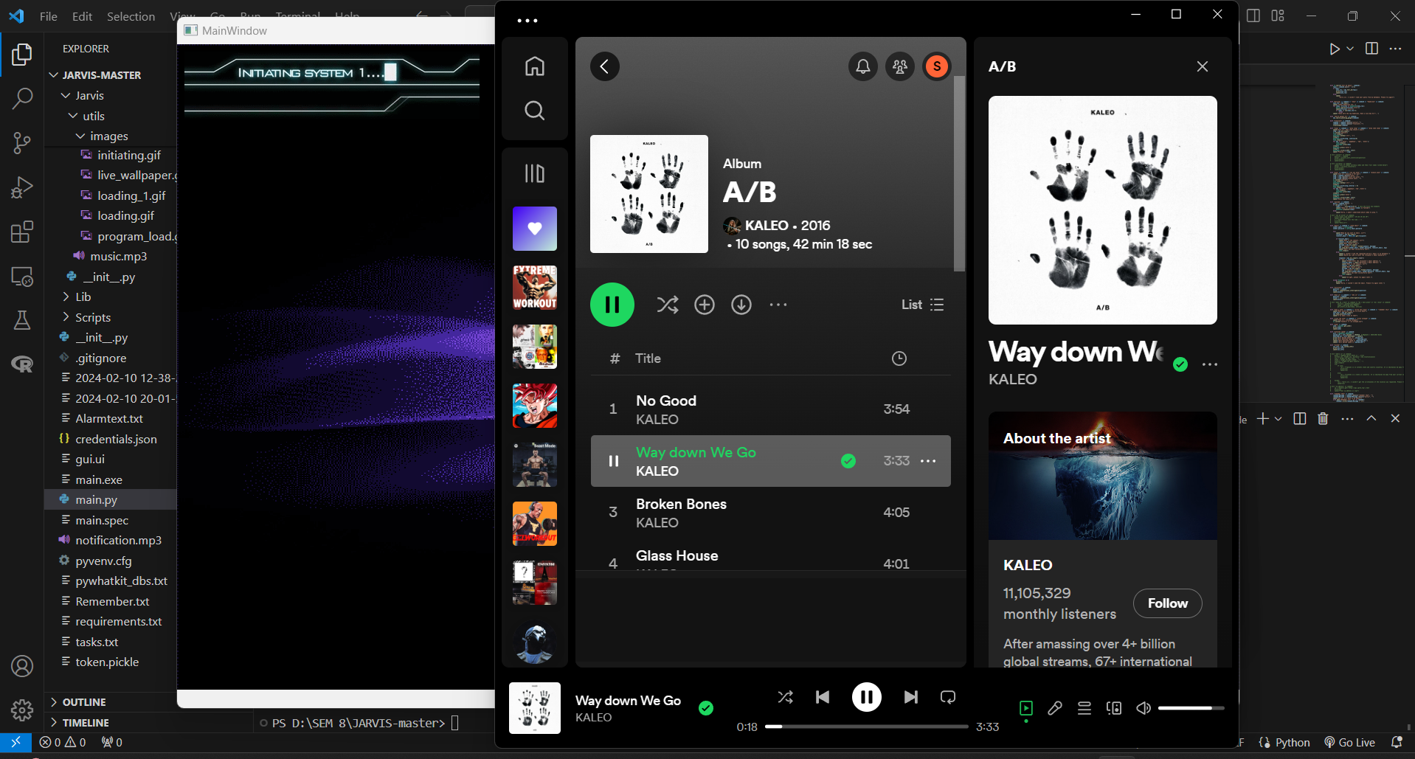
Results – Playing Music
5.7

Slide 34
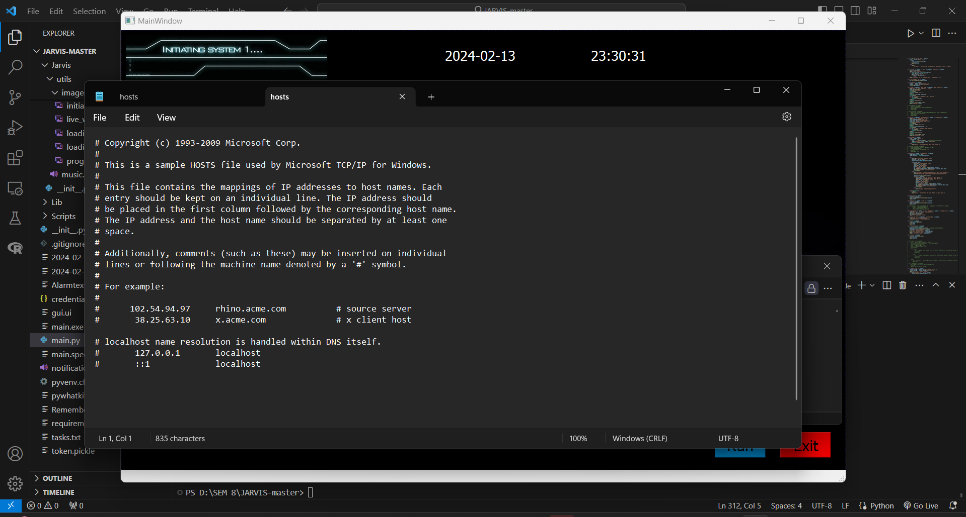
Results – Open Applications
5.7

Slide 35
06
What is to done next

Slide 36

06
What is to done next
The voice assistant project has made significant progress, completing 70% of its modules, including functionalities for time and date, weather forecast, language translation, web searches, music playback control, text messaging, and application launching.
To further enhance its functionality, the project now aims to implement two remaining modules: unit conversion for seamless conversions of various units like currency, temperature, and distance, and setting alarms to allow users to schedule reminders or timers using voice commands.

Slide 37
07
Guide Approval Mail
Snapshot

Slide 38
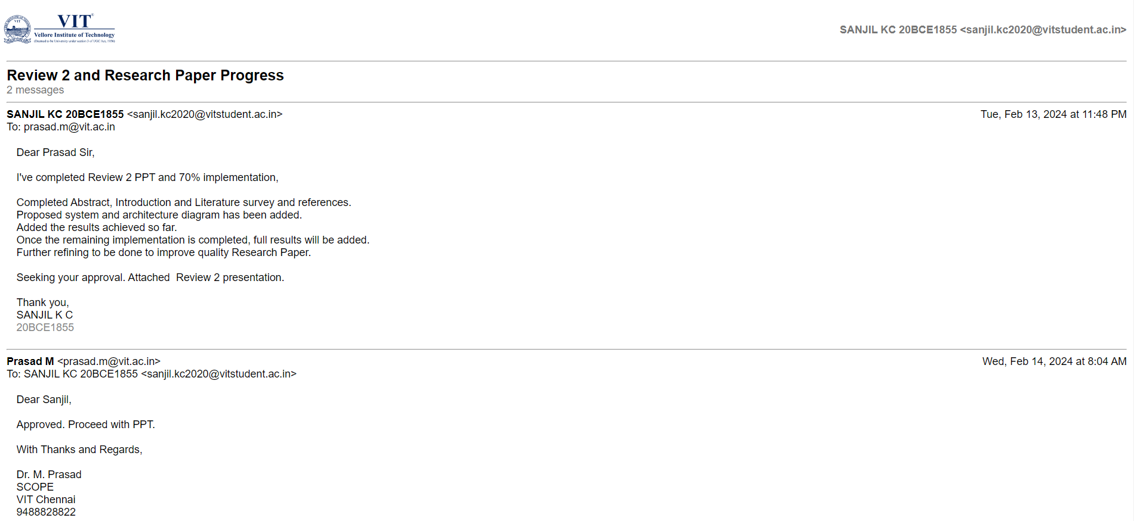
Guide Approval Mail
Snapshot
7

Slide 39
08
Research Paper Status

Slide 40
08
Research Paper Status
Added the results achieved so far
Once the remaining implementation is completed, full results will be added.
Completed Abstract, Introduction and Literature survey and references
Further refining to be done to improve quality
Proposed system and architecture diagram has been added.

Slide 41
09
References

Slide 42
09
References
V. Appalaraju, V. Rajesh, K. Saikumar, P. Sabitha and K. R. Kiran, "Design and Development of Intelligent Voice Personal Assistant using Python," 2021 3rd International Conference on Advances in Computing, Communication Control and Networking (ICAC3N), Greater Noida, India, 2021, pp. 1650-1654, doi: 10.1109/ICAC3N53548.2021.9725753.
S. D. Vara Prasad, J. Kavitha, G. C. Babu, K. V. M. Mohan and P. G. Krishna, "An Advanced Computerized Artificial Intelligent System for Assisting Real Life Feature Extraction using AI-NOVA," 2023 5th International Conference on Smart Systems and Inventive Technology (ICSSIT), Tirunelveli, India, 2023, pp. 1337-1342, doi: 10.1109/ICSSIT55814.2023.10061087.
T. M. N. Vamsi, B. Suchitra, S. Kumar, K. V. V. Varma and K. N. S. H. Kumar, "An IoT based Smart Home with Virtual Assistant," 2021 6th International Conference for Convergence in Technology (I2CT), Maharashtra, India, 2021, pp. 1-4, doi: 10.1109/I2CT51068.2021.9417883.
M. S. Devi, N. S N, M. Nirmala, V. A and Y. G. K K, "LARVIS - Linux AIRelied Virtual Intelligent System," 2023 Eighth International Conference on Science Technology Engineering and Mathematics (ICONSTEM), Chennai, India, 2023, pp. 1-7, doi: 10.1109/ICONSTEM56934.2023.10142584.
A. Jagan, M. Ghouse Pasha, D. Nandini, H. Susanna and D. N. Parvathi, "Personal Voice Assistant Using Computer Vision," 2023 International Conference on Research Methodologies in Knowledge Management, Artificial Intelligence and Telecommunication Engineering (RMKMATE), Chennai, India, 2023, pp. 1-8, doi: 10.1109/RMKMATE59243.2023.10369477.

Slide 43
09
References
P. Kunekar, A. Deshmukh, S. Gajalwad, A. Bichare, K. Gunjal and S. Hingade, "AI-based Desktop Voice Assistant," 2023 5th Biennial International Conference on Nascent Technologies in Engineering (ICNTE), Navi Mumbai, India, 2023, pp. 1-4, doi: 10.1109/ICNTE56631.2023.10146699.
S. P. Yadav, A. Gupta, C. Dos Santos Nascimento, V. Hugo C. de Albuquerque, M. S. Naruka and S. Singh Chauhan, "Voice-Based Virtual-Controlled Intelligent Personal Assistants," 2023 International Conference on Computational Intelligence, Communication Technology and Networking (CICTN), Ghaziabad, India, 2023, pp. 563-568, doi: 10.1109/CICTN57981.2023.10141447.
R. Aldhafiri, G. Powell, E. Smith and C. Perera, "Voice-Enabled Privacy Assistant Towards Facilitating Successful Ageing in Smart Homes," 2023 IEEE International Conference on Pervasive Computing and Communications Workshops and other Affiliated Events (PerCom Workshops), Atlanta, GA, USA, 2023, pp. 343-345, doi: 10.1109/PerComWorkshops56833.2023.10150259.
P. N. Singh, N. M. and P. V. Tijare, "Operating System Command Execution Using Voice Command," 2023 3rd Asian Conference on Innovation in Technology (ASIANCON), Ravet IN, India, 2023, pp. 1-5, doi: 10.1109/ASIANCON58793.2023.10269894.
P. Dalal, T. Sharma, Y. Garg, P. Gambhir and Y. Khandelwal, "“JARVIS” - AI Voice Assistant," 2023 1st International Conference on Innovations in High Speed Communication and Signal Processing (IHCSP), BHOPAL, India, 2023, pp. 273-280, doi: 10.1109/IHCSP56702.2023.10127134.

Slide 44
09
References
D. K. Yadlapally, B. Vasireddy, M. Marimganti, T. Chowdary, C. Karthikeyan and T. Vignesh, "A Review on the Potential of AI Voice Assistants for Personalized and Adaptive Learning in Education," 2023 7th International Conference on Computing Methodologies and Communication (ICCMC), Erode, India, 2023, pp. 422-427, doi: 10.1109/ICCMC56507.2023.10084208.
B. Savić, M. Milić and S. Vlajić, "Analysis and Development of the Model for Google Assistant and Amazon Alexa Voice Assistants Integration," 2023 27th International Conference on Information Technology (IT), Zabljak, Montenegro, 2023, pp. 1-4, doi: 10.1109/IT57431.2023.10078705.
S. Chauhan and D. Arora, "Development of Cloud based Smart Voice Assistant using Amazon Web Services," 2023 2nd International Conference on Applied Artificial Intelligence and Computing (ICAAIC), Salem, India, 2023, pp. 1217-1221, doi: 10.1109/ICAAIC56838.2023.10140284.
D. Lahiri, P. C. P. Kandimalla and A. Jeysekar, "Hybrid Multi Purpose Voice Assistant," 2023 2nd International Conference on Applied Artificial Intelligence and Computing (ICAAIC), Salem, India, 2023, pp. 816-822, doi: 10.1109/ICAAIC56838.2023.10140365.
.Y. Lee, N. Kim, J. Jeong and I. -Y. Kwak, "Experimental Case Study of Self-Supervised Learning for Voice Spoofing Detection," in IEEE Access, vol. 11, pp. 24216-24226, 2023, doi: 10.1109/ACCESS.2023.3254880.

Slide 45
09
References
Abhay Dekate, Chaitanya Kulkarni, Rohan Killedar, "Project of Voice Controlled Personal Assistant Device", International Journal of Computer Trends and Technology (IJCTT) - Volume 42 Number 1 December 2016.
Deny Nancy, Sumithra Praveen, Anushria Sai, M.Ganga, R.S.Abisree, "Voice Assistant Application for a college Website", International Journal of Recent Technology and Engineering (IJRTE) ISSN: 2277-3878, Volume-7,April 2019.
Deepak Shende, Ria Umahiya, Monika Raghorte, Aishwarya Bhisikar, Anup Bhange, "Al Based Voice Assistant Using Python", Journal of Emerging Technologies and Innovative Project (JETIR), February 2019, Volume 6.
Dr.Kshama V.Kulhalli, Dr.Kotrappa Sirbi, Mr.Abhijit J. Patankar, "Personal Assistant with Voice Recognition Intelligence", International Journal of Engineering Project and Technology. ISSN 0974-3154 Volume 10, Number 1 (2017).
Y. Lee, N. Kim, J. Jeong and I. -Y. Kwak, "Experimental Case Study of Self-Supervised Le. Isha S. Dubey, Jyotsna S. Verma, Ms.Arundhati Mehendale, "An Assistive System for Visually Impaired using Raspberry Pi", International Journal of Engineering Project & Technology (IJERT), Volume 8, May-2019.arning for Voice Spoofing Detection," in IEEE Access, vol. 11, pp. 24216-24226, 2023, doi: 10.1109/ACCESS.2023.3254880.

Slide 46
THANKS

